Slide 1
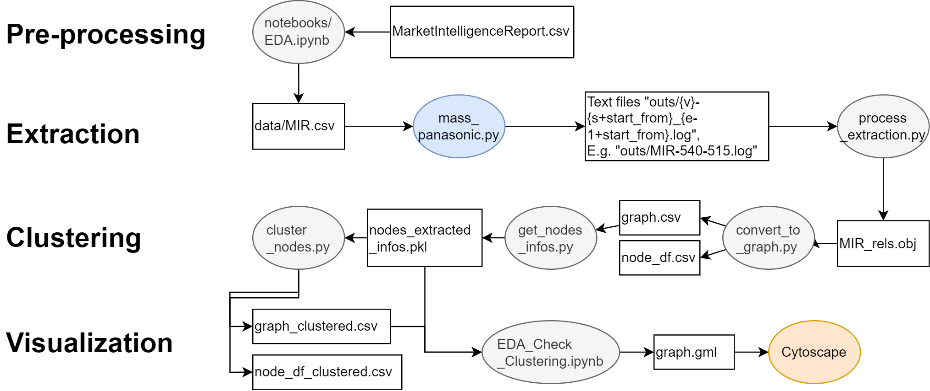

Slide 2
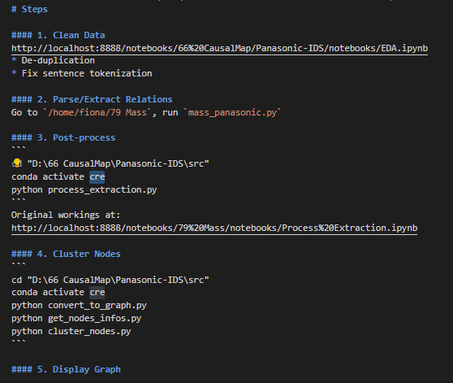
README.md
mass_Panasonic.py is missing
It’s from another repository. I’ve uploaded the codes under “extraction” folder.
Conda environment setting file ‘cre’ missing
I uploaded the environment yml file to replicate.

Slide 3
Qns:
entire script of `mass_panasonic.py` is missing
This script is under “Mass”, a repository to extract causal relations. I’ve uploaded the codes under “extraction” folder. It relies on more dependencies, see “requirements.txt”.
2. inside 'Evaluate Extraction.ipynb', missing source file of "20230313_MIR_rels.obj", can explain how and which script file / jupyter notebook create this file?
See Figure, after “mass_panasonic.py”. I just renamed the file to save it according to the date I parsed, hence the additional prefix “20230313”.
3. inside 'Summarization for Nodes.ipynb', missing source file of "node_df_spans.csv", can explain how and which script file / jupyter notebook create this file?
These are working files when I was trying alternative methods to represent the nodes. They are somewhat equivalent to “node_df.csv”. You can ignore them, we do not use them in the end.
4. inside 'EDA_Check Extraction.ipynb', missing file of 'MIR-540_554.log', can explain how and which script file / jupyter notebook create this file?
See Figure, after “mass_panasonic.py”, we obtain a folder full of logs.

Slide 4
My suggestion is that you try to replicate from “process_extraction.py” onwards first
I’ve uploaded the extracted log files under “extraction/outs.zip” for you to start from “process_extraction.py”
If we are set on the methodology, can combine the code into one shell script.
Easy since all are “.py” scripts.
Only the “.ipynb” one needs to refactor

